Slide 1
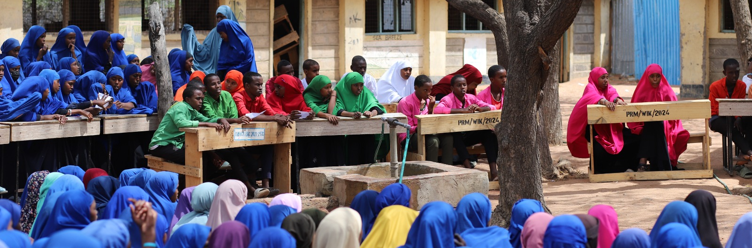
The Life of a Teacher/Worker in Migrant Community Settings
By Norman Kemboi, IIDEMIC Administrator (Dadaab)

Slide 2
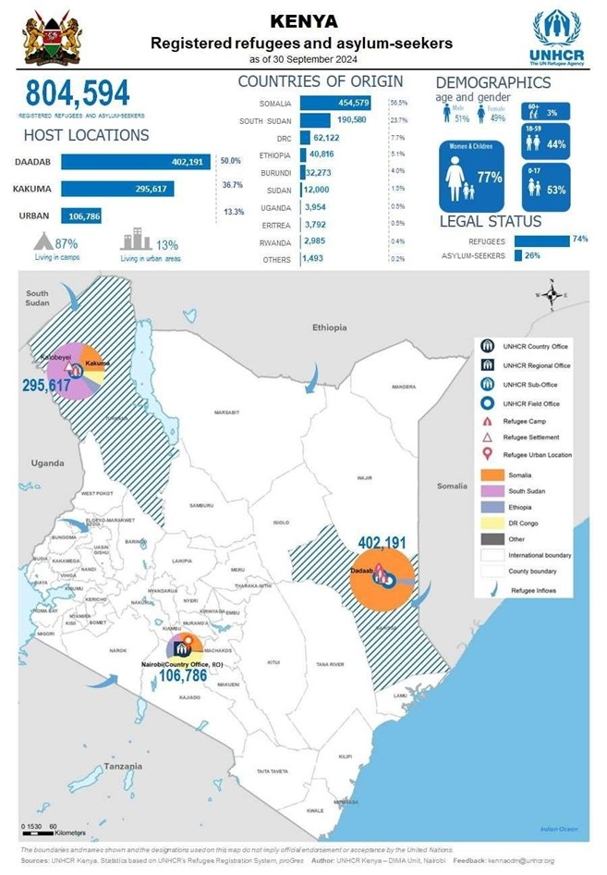
Introduction
Context of Migrant Education
Dadaab Overview: A sprawling refugee complex sheltering nearly 500,000 refugees from diverse backgrounds, primarily Somali, Ethiopian, Congolese and South Sudanese.
ASAL (Arid and Semi-Arid Land) region with unique socio-economic challenges.
The diversity of the community, ranging from children to the elderly, including persons with disabilities (PWDs).
Education’s Role: A critical lifeline for refugees, providing hope, skills, and opportunities for better futures.

Slide 3
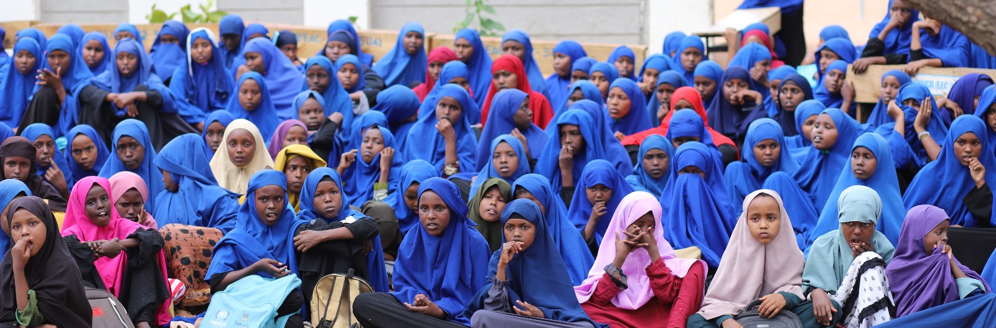
What would you do if you had to teach in a classroom with over 100 students from diverse traditions, cultures, and linguistic backgrounds, particularly in a migrant setting where students come from varied and often challenging origins??

Slide 4
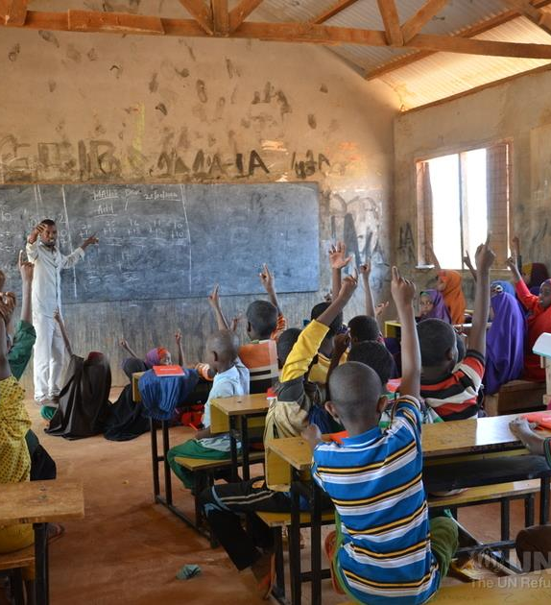
Challenges Faced by Teachers/Worker

Slide 5
Challenges Faced by Teachers/Worker
1. Resource Constraints
Fact: In Dadaab, classrooms often have 80–120 students, with only a chalkboard and limited textbooks shared among five or more students.
Inaccessible and non-disability-friendly schools for children with disabilities.
Shortages of teachers for Islamic Religious Education (IRE), Christian Religious Education (CRE), Kiswahili, and Special Needs Education (SNE).
Limited teaching materials, including Braille for children with disabilities.
Limited digital tools, assistive technologies for PWDs, and access to quality teaching materials.

Slide 6
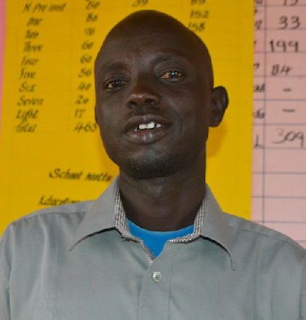
Challenges Faced by Teachers/Worker
1. Resource Constraints
Peter Atum is the head teacher at Friends Family School. He faces many challenges - one of them is a lack of trained teachers. The school has 19 teachers and only three of them are trained, including him. So, they spend a lot of their weekends preparing lesson plans to enable the other teachers to do their work. Peter said he hopes "there are well-wishers or the Kenyan government to kindly train the teachers and equip them with necessary tools so that the school can get the right skills to teach the students".
Peter told me, “Sometimes I feel helpless when I can’t provide individual attention to all my students.”

Slide 7
Challenges Faced by Teachers/Worker
2. Emotional and Psychological Strain
Psychological and emotional burdens on both teachers and students due to past trauma or displacement. Many students arrive with trauma from conflict and displacement.
Teachers experiences challenges such as working with students with disabilities and overcoming resistance to new teaching methods.
A teacher shared a story of a 12-year-old boy who struggled to focus because he lost his parents during the journey to Kenya. The teacher acted as a counselor, guiding the boy through grief while maintaining classroom discipline.

Slide 8
Challenges Faced by Teachers/Worker
3. Cultural and Linguistic Barriers
Teachers often deal with students speaking Somali, Oromo, or South Sudanese languages, requiring creative ways to bridge gaps.
Refugee teachers teaching in local Somali dialects, excluding minority groups.
These among other reason, makes communication and curriculum delivery complex.
Peter, confessed that - even with 10 years’ experience in teaching - he still has a challenge attending the children of different cultures who share different norms. "A joke to one community can be an insult to another community so you have to learn how to solve these problems," he said.

Slide 9
Rewards and Opportunities

Slide 10
Rewards and Opportunities
Transformative Impact
Teachers witness students breaking barriers.
Example: A Somali refugee girl in Dadaab graduated and became a community health worker, returning to mentor others in her community.
Community Trust and Bonding
Refugee teachers and workers often serve as role models.
Example: A teacher in Dagahaley Camp organized weekend mentorship sessions, building trust and reducing dropout rates.

Slide 11
Rewards and Opportunities (Cont..)
Resilience and Innovation
Teachers often use locally available materials to overcome resource shortages.
Promoting Soft Skills- the integration of 21st-century skills, such as: Communication, collaboration, critical thinking, and digital literacy, will empower teachers to nurture entrepreneurial and innovative abilities among students.
Example: In one camp, teachers crafted science models from recycled plastic bottles to teach biology.

Slide 12

Rewards and Opportunities (Cont..)
Existing Community Capacities
Community-led education initiatives, informal learning centers, and volunteer efforts.
Support from religious leaders and organizations advocating for education.
School feeding programs improving children's concentration.
Awareness campaigns discouraging child labor, early marriage, and drug abuse.

Slide 13

Rewards and Opportunities (Cont..)
Professional Growth
Programs like IIDEMIC will provide specialized training.
Capacity Building for Teachers- Introduction of Inclusive Education Modules to equip teachers with skills for inclusive pedagogy.

Slide 14

IIDEMIC's Role in Supporting Teachers
Capacity Building
IIDEMIC will train teachers in pedagogy, trauma-informed approaches, and inclusivity.
Collaboration with Stakeholders
Partnerships with the Ministry of Education, NGOs like Windle International Kenya, LWF, and the UNHCR.
A joint training program will improve teachers' abilities to handle large classrooms effectively.

Slide 15

IIDEMIC's Role in Supporting Teachers (Cont..)
Providing Resources and Support
Distribution of teaching kits, including textbooks, lesson plans, and digital tools, and tablets.
the introduction of tablets will enable interactive learning sessions.
Sustainability
IIDEMIC's focus is not just on immediate impact but on building systems to ensure long-term teacher support.
I am certain that the mentorship program will pair experienced teachers with newcomers for skills transfer.

Slide 16

Call to Action
Key Takeaways
Teaching in migrant communities is demanding but immensely fulfilling.
Teachers are not just educators; they are mentors, counselors, and pillars of hope.
Working in a migrant setup has changed my perspective on resilience, inclusivity, and education. It can also change yours!
Call to Action
Stakeholders must prioritize investment in teacher training, resources, and well-being.
As educators, let’s advocate for inclusive and supportive policies.
All stakeholders to consider supporting initiatives like IIDEMIC to build sustainable, inclusive futures for refugee communities.
I look forward to immense collaboration among governments, NGOs, and educational institutions to strengthen migrant education systems.

Slide 17
Migration is a “fact of life” and a “force for good”, UN Secretary-General António Guterres Thank you!
Norman Kemboi
+254768704834
Kemboi.norman1@gmail.com
IIDEMIC Administrator (Dadaab)

